Slide 1
Dance of the continents
An Introduction to Plate Tectonics

Slide 2
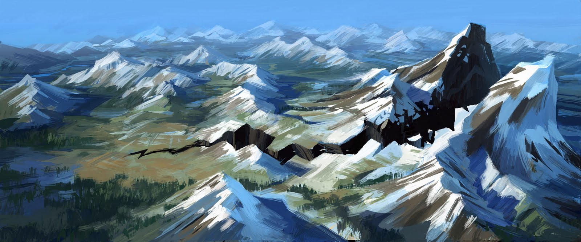
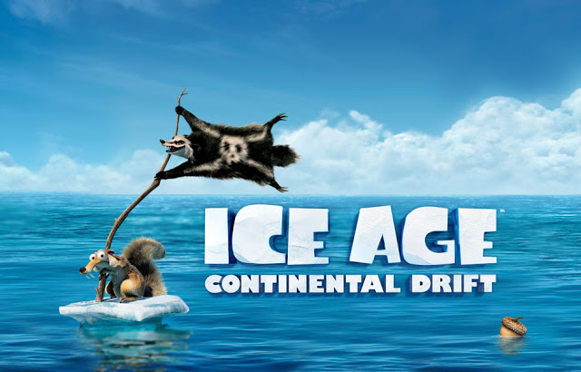
Preconceptions
Scrat’s Continental Crack-Up
youtube.com/watch?v=q_IYQdKkWsU&feature=youtu.be

Slide 3
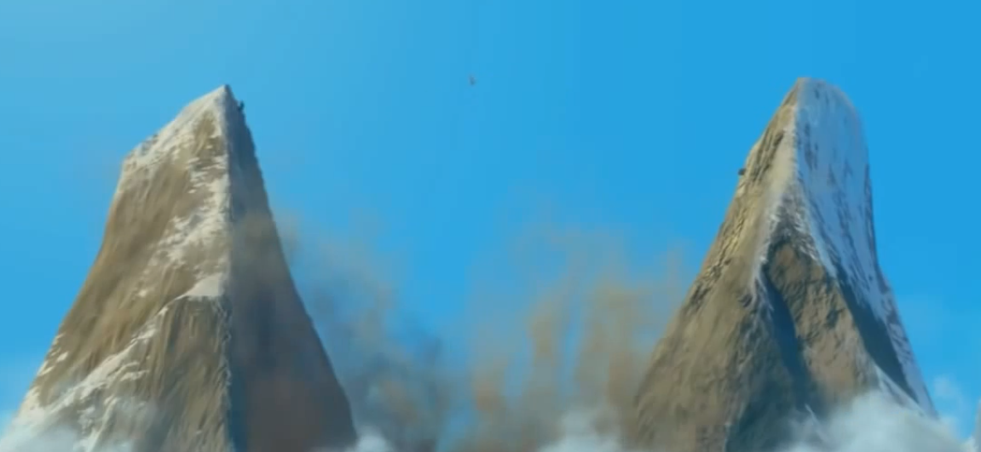
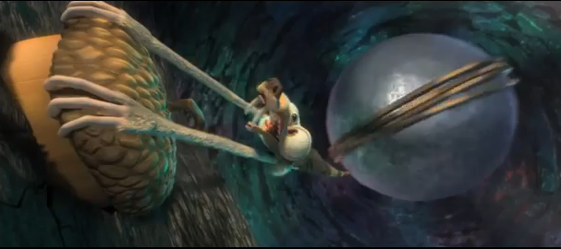
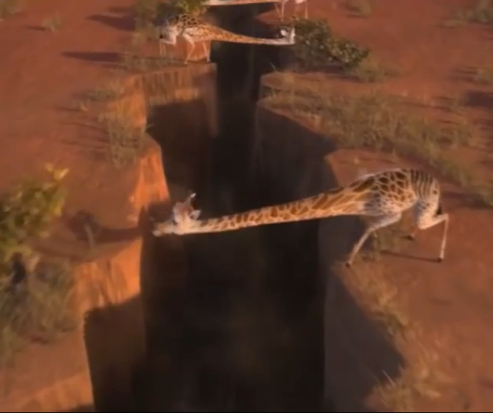
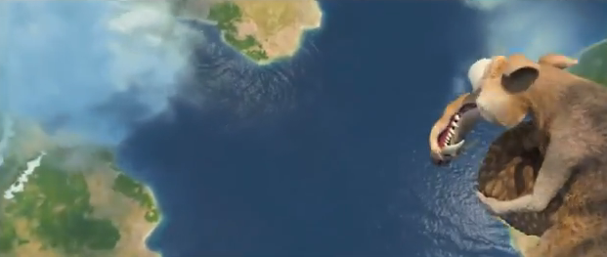
What did they get wrong?
Notes:
Ask audience what they know about continental drift or plate tectonics?

Slide 4
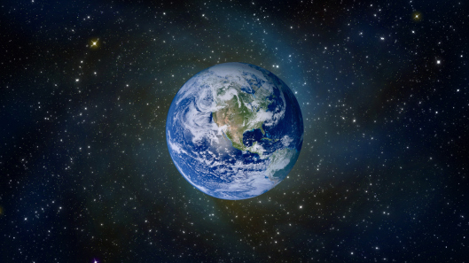
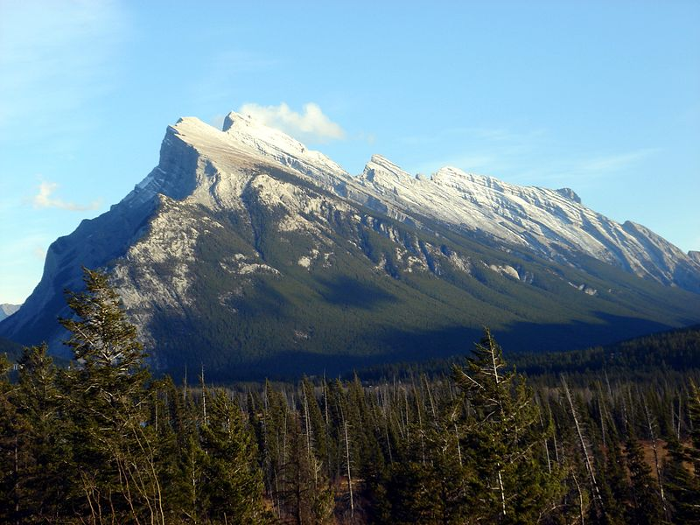
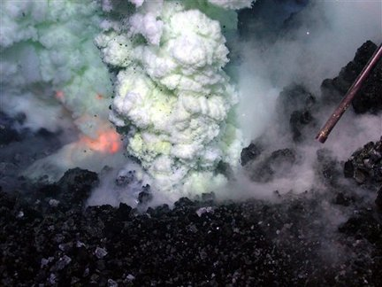
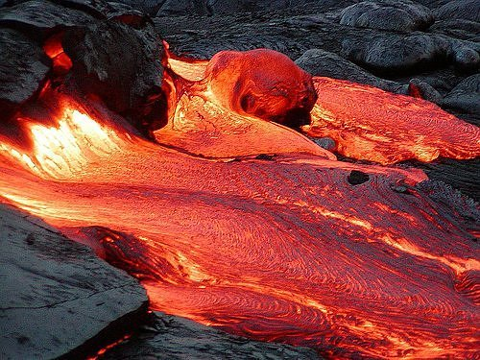
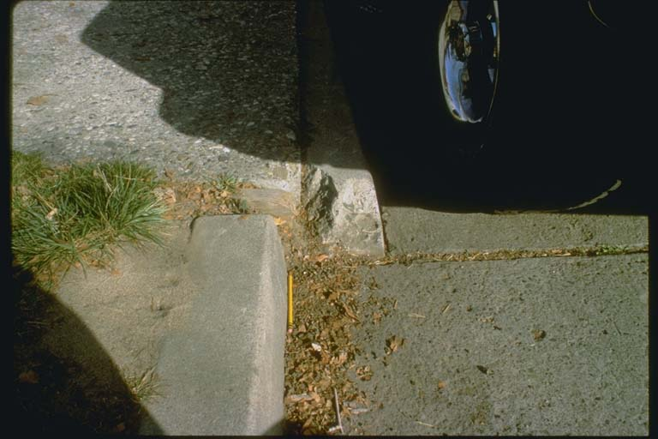
What global mechanisms control geology?

Slide 5
Thinking about continents…
1596
Cartographer Abraham Ortelius
Questioned idea that continents have always been where they are
1620
English scientist Francis Bacon
Noticed the puzzle piece nature of Africa and South America

Slide 6
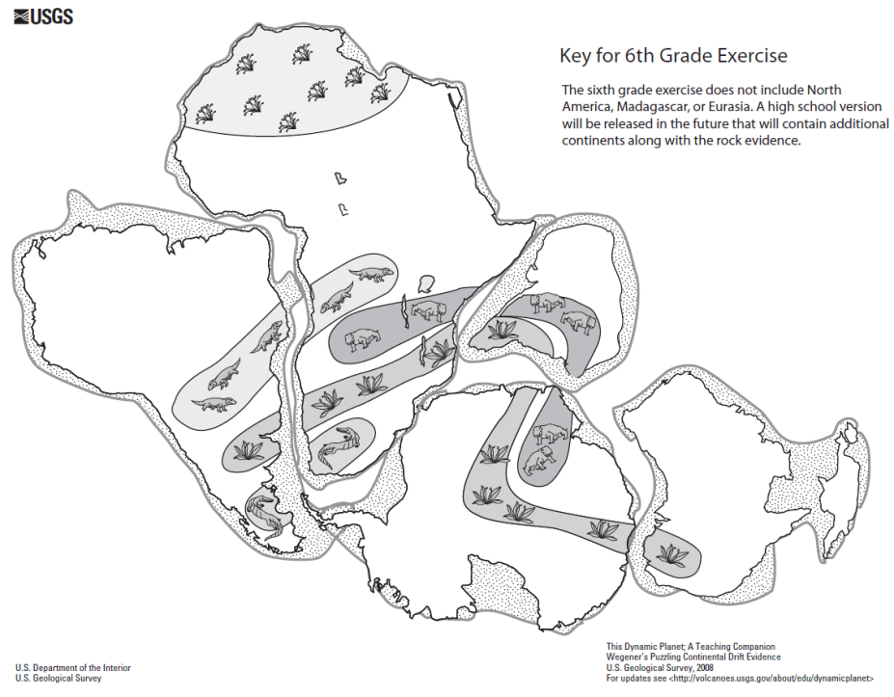
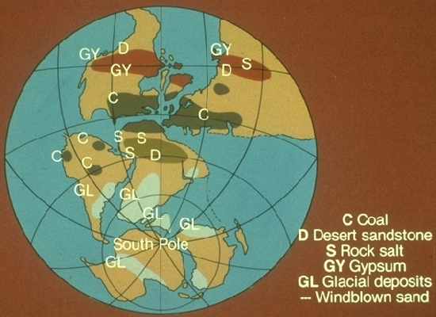
Continental Drift Theory
1910
American geologist Frank Taylor
Suggested mountains are due to movement of continents
1912
German meteorologist Alfred Wegener
Continental drift theory and the supercontinent Pangea
Distribution of fossils
Resemblance of geological structures
Distribution of ancient glacial deposits found near equator

Slide 7
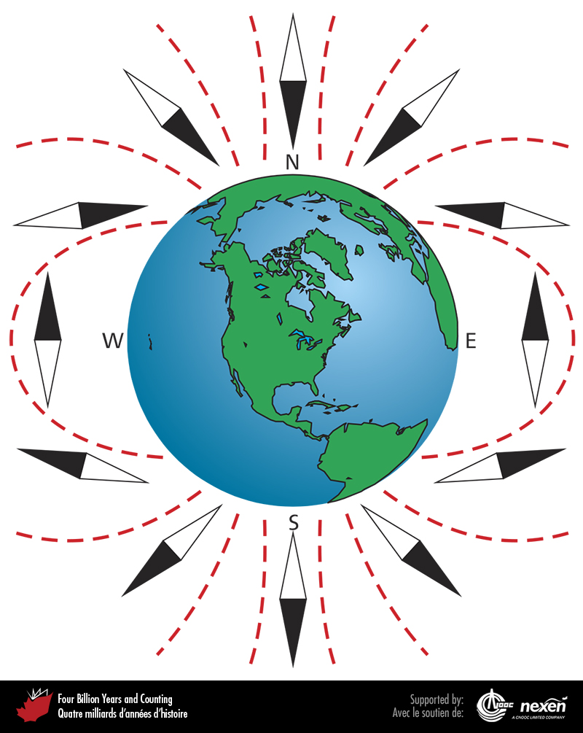
Magnetic Proof
Proof of continental drift
1950s
Earth has a magnetic field, resembling a dipole magnet
Iron-bearing minerals cooling in the Earth preserve the inclination of this magnetic field

Slide 8
Magnetic Proof
Inclination is dependant on latitude of mineral at time of cooling
Using rocks of same age on different continents, we can place the continents in there original location

Slide 9
Magnetic Proof
Inclination is dependant on latitude of mineral at time of cooling
Using rocks of same age on different continents, we can place the continents in there original location
But how do the continents move?
By what mechanism?

Slide 10
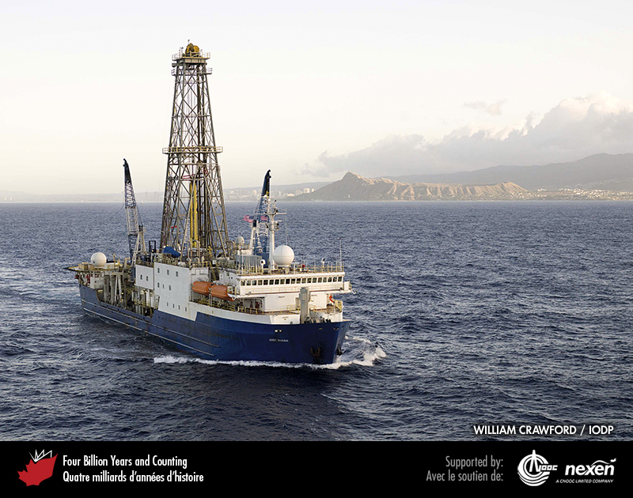
Mapping the Seafloor
1950s
Laying of submarine telephone cables
Detection of 65,000km long ridge in Atlantic Ocean
Detection of deep continuous trenches encircling Pacific ocean

Slide 11
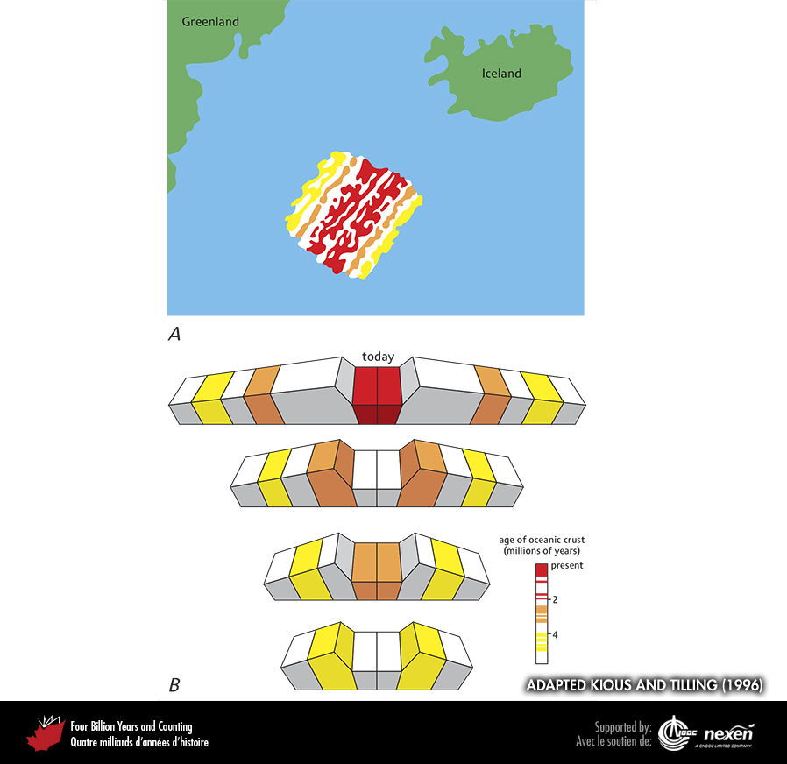
Mapping the Seafloor
1960s
Sea floor drilling - ocean floor is primarily basalt with a thin sediment layer
Magnetometers measured magnetic polarity of ocean floor
Notice of stripes parallel to ridge
Magnetic reversals
Symmetrical across ridge
Conveyor belt like process

Slide 12
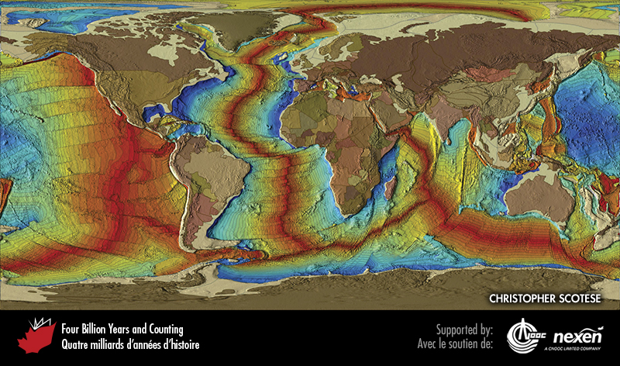
Age of the Seafloor
Red-Yellow: 0-70 million years old
Green-Blue: 70-180 million years old

Slide 13
Seafloor Spreading
1962
American geologist Harry Hess
Oceanic ridge lies above diverging upwelling currents of convection cells in the mantle
Currents spread laterally at base of lithosphere
Pulling apart lithosphere – intruded by mafic magma
Pushing older seafloor away from ridge
BUT… oldest seafloor is only 180 million years old?
Where did the older crust go?
Notes:
K-Ar dating of ocean floor

Slide 14
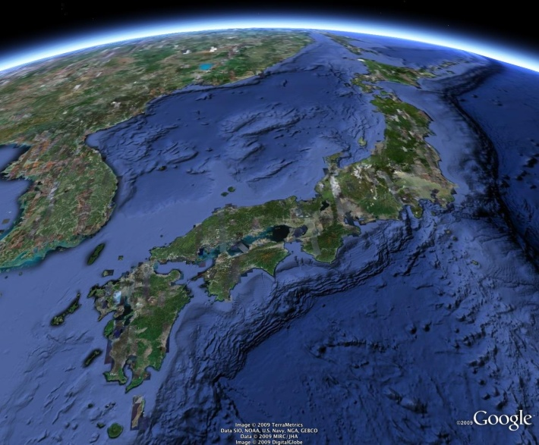
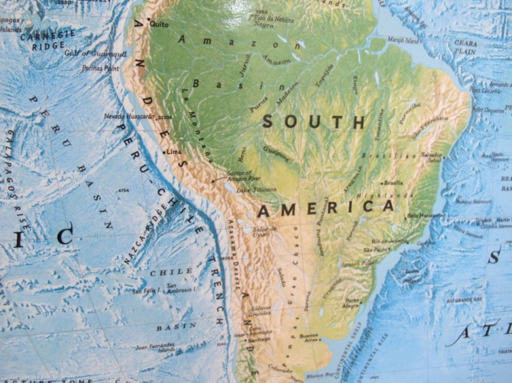
Oceanic Trenches of the Pacific
Japan
Many recorded earthquakes
Active volcanoes
Deep oceanic trench
Western coast of South America
Many recorded earthquakes
Active volcanoes
Deep oceanic trench

Slide 15
Oceanic Trenches of the Pacific
Japan
Many recorded earthquakes
Active volcanoes
Deep oceanic trench
Western coast of South America
Many recorded earthquakes
Active volcanoes
Deep oceanic trench
In-class exercise – Earthquake Evidence and Plate Boundaries

Slide 16
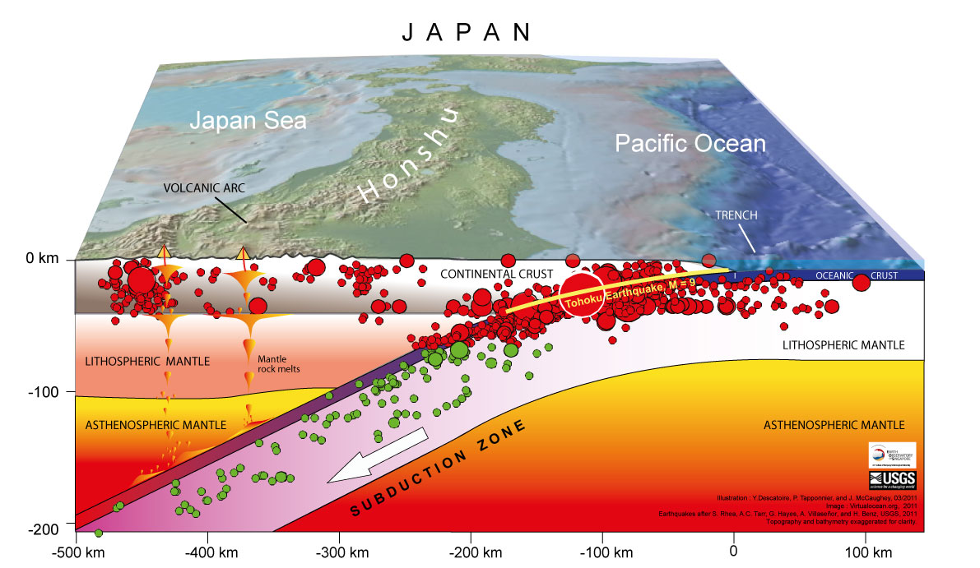
Japanese Earthquakes
1928
Geophysicist Kiyoo Wadati
Maps the depth and location of epicenters of earthquakes
Discovered an inclined surface sloping 60° beneath the Japanese Island, and beginning at the base of the deep trench

Slide 17
Subduction
Earthquakes result of downward movement of ocean floor on large scale reverse faults
Older seafloor sinks into the mantle along these subduction zones

Slide 18
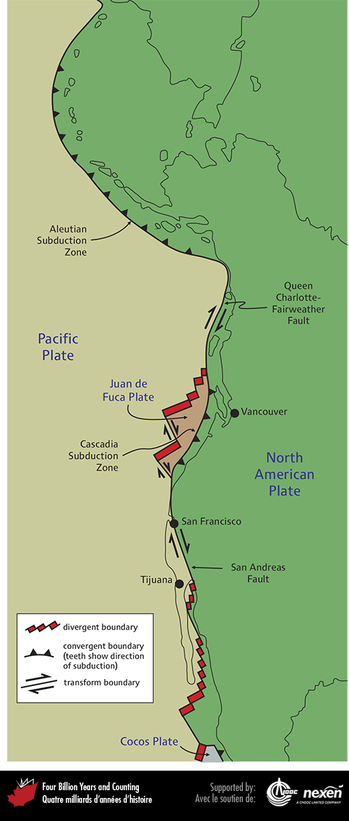
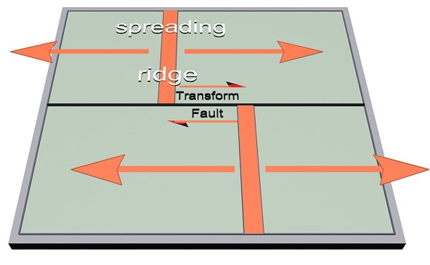
Transform Faults
Early 1960s
Canadian researcher Tuzo Wilson
Large scale seismically active transform faults
Truncating and offsetting ridges and subduction zones

Slide 19
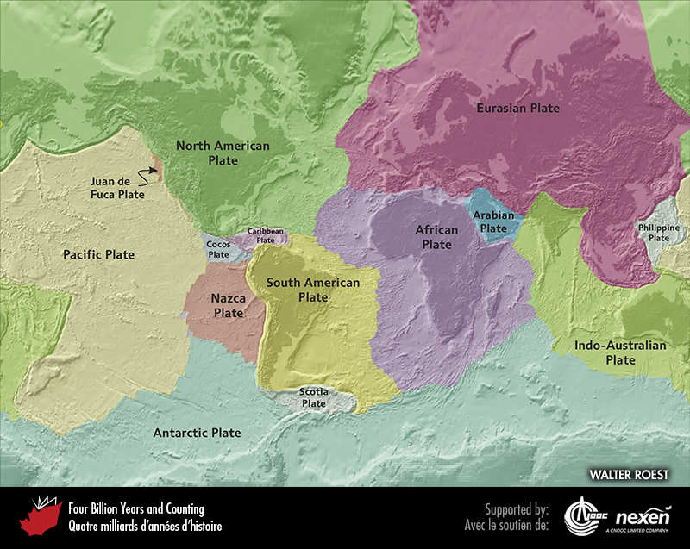
Plate Boundaries
https://www.youtube.com/watch?v=Z1b3yNgIfKw
Earth divided into rigid lithospheric plates
Boundaries defined by transform faults, spreading ridges and subduction zones
Plates are constantly moving relative to each other

Slide 20
Plate Boundaries
Earth divided into rigid lithospheric plates
Boundaries defined by transform faults, spreading ridges and subduction zones
Plates are constantly moving relative to each other
In-class exercise – GPS Data and Plate Motion

Slide 21
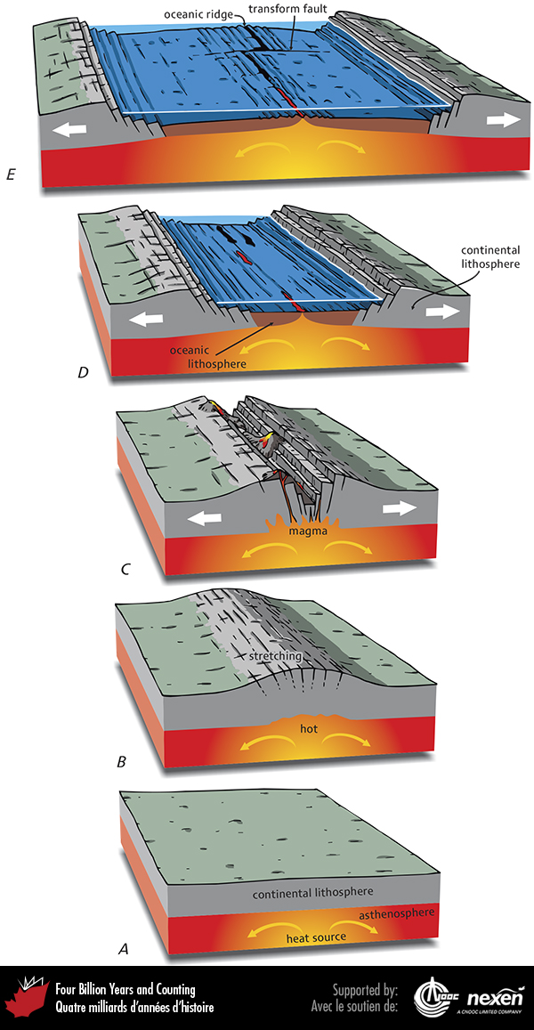
Divergent Boundaries
Rifting
Upwelling heat from mantle
Doming of continental land
Rifting and extrusion of magma
Small ocean basin formed
Large ocean basin with a mid-ocean ridge

Slide 22
Convergent Boundaries
Ocean-ocean convergence
Island Arcs
Ex: Japan
Ocean-continent convergence
Continental Arc
Ex: Andes in S. America
Continent-continent convergence
Mountain belts – orogens
Ex:Himalayas

Slide 23
Mountain Building - Orogenesis
https://www.youtube.com/watch?v=d9bKXY0OMxc

Slide 24
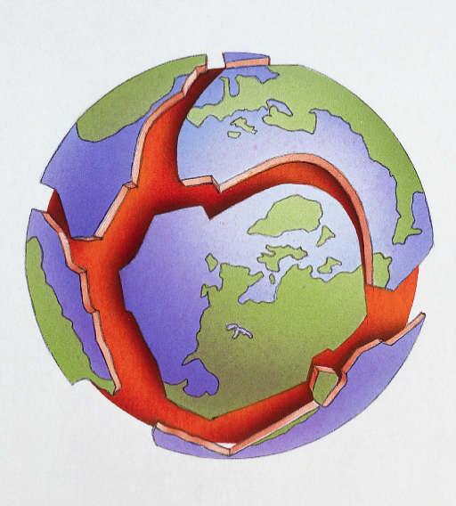
Plate Tectonics – A Summary
Unifying theory that took centuries to develop
Describes the mechanisms by which the geology we see today is created
Earth is divided into rigid lithospheric plates which are constantly moving relative to each other
Plate movement is driven by convection in the mantle
Plate boundaries are either convergent (subduction and mountain building) or divergent (rifting and mid-ocean ridges)

